Slide 1
Credit Card Segmentation Visualization
Sanket Mote
Tableau Visualization

Slide 2
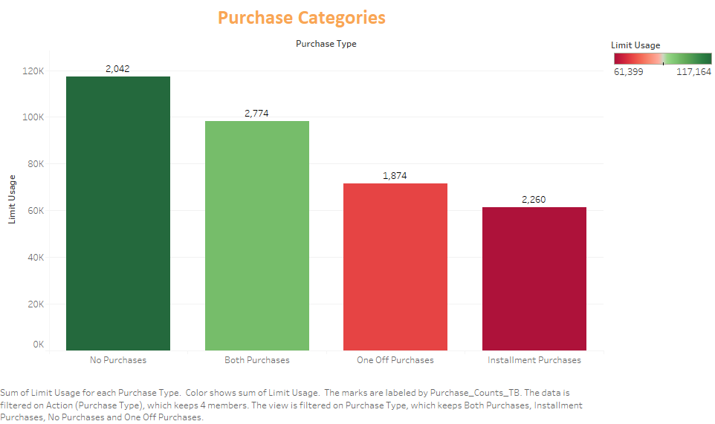

Slide 3
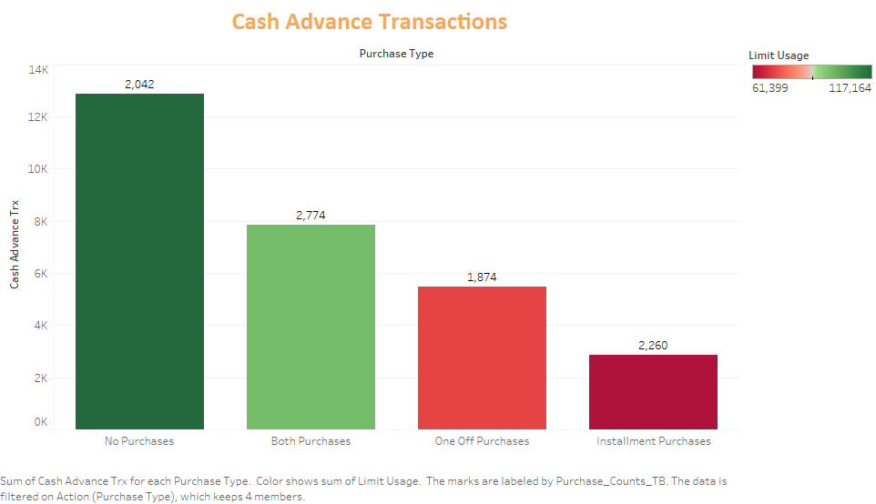

Slide 4
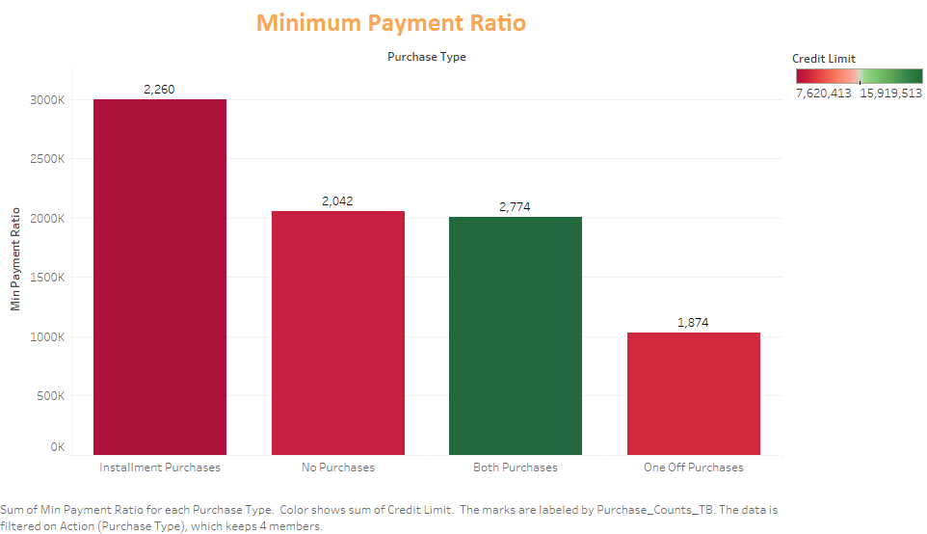

Slide 5
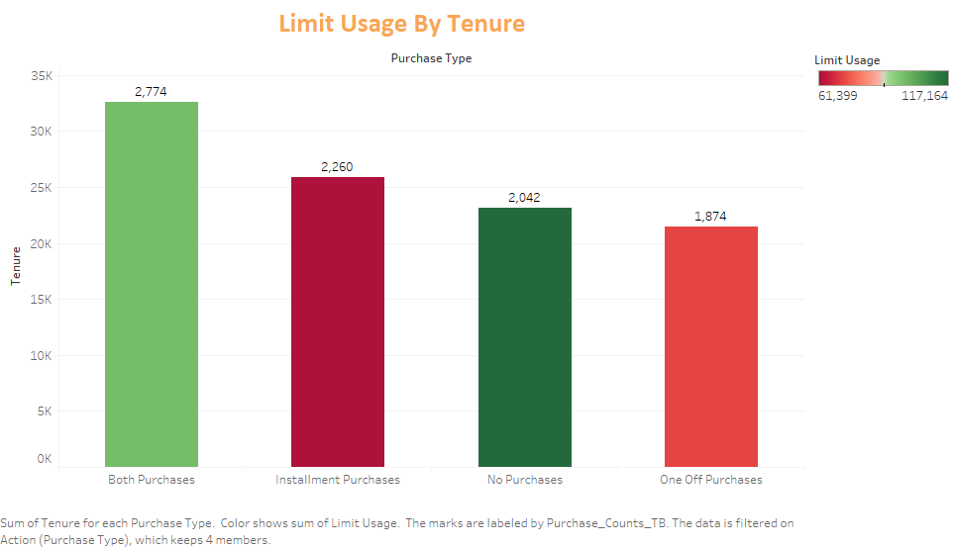

Slide 6
